Slide 1

MGM Institute of Physiotherapy
Aurangabad
MAHATMA GANDHI MISSION
Didactic Lecture

Slide 2
Assessment of Lumbar Spine
Dr. surendra Wani
Dept. Of Musculoskeletal Physiotherapy
MGM Institute Of Physiotherapy
Chh. Sambhajinagar

Slide 3
Objectives
To understand and demonstrate the procedures for performing Lumbar spine assessment.

Slide 4
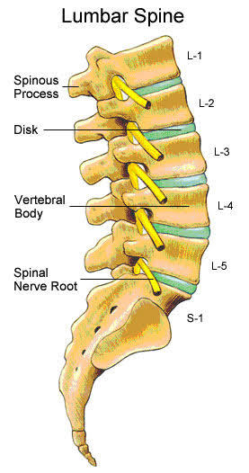
INTRODUCTION
L1-L5
Large size
Kidney shaped body
Absence of foramen in
transverse process
10 pairs of facet joints
Resting and closed pack
position

Slide 5
DEMOGRAPHIC DATA
Name
Age
Gender
Occupation
Religion
Dominance
D.O.A and D.O.E
IPD/OPD No

Slide 6
CHIEF COMPLAINTS
Back pain (Where?)
Reduced range of motion
Weakness and sensory loss
Conditions include -
Low back pain, spondylosis, spondylolysis, spondylolisthesis, retrolisthesis, sciatica, scoliosis,cauda equina syndrome, lumbar disc herniation, lower cross syndrome, PIVD,SI joint dysfunction, lumbar canal stenosis, repetative stress disorder

Slide 7
HISTORY OF PRESENTING ILLNESS
1. What was the mechanism of injury and how did it occur ?
2. If major trauma was involved?
3. Has the lumbar spine injured before?
4. What is patient able and unable to do functionally?
5. How long has the problem bothered the patient?

Slide 8
PAIN ASSESSMENT
a) What is the area of current symptoms ?
b) What type and quality of pain is exhibited ?
c) How much the intensity and duration of pain ?
d) What is the nature of pain ?
e) What type of sensations does the patient feel, and where are these abnormal sensations ?
f) Aggravating factors ?
g) Easing factors ?
h) Any radiation of pain?

Slide 9
CONTD..
h) Any radiation of pain?
i) Is there any pain associated with laughing ,coughing, sneezing, deep breathing?
j) Diurnal variation of pain?
k) Is paraesthesia or anesthesia present?

Slide 10
CONTD
SPECIAL QUESTIONS
Has the patient undergoes x-ray examination or other imaging techniques ?
PAST HISTORY
Does the patient have a history of surgery or past /present illness ?
DRUG HISTORY
Has the patient been receiving analgesics, steroids or any other medications ? If so, for how long ?

Slide 11
PERSONAL HISTORY
a) What is the patients sleeping position ?
b) Does the patient have any sleeping problem ? His sleeping position
c) Bowel / Bladder- Difficulty in micturation?
d) Appetite
OCCUPATIONAL HISTORY
What is the patient occupation ?
What does the patient do at work ?

Slide 12
SOCIO-ECONOMIC HISTORY
What is the social status of the patient ?
Educational status of the patient ?
Kuppuswami scale
ENVIRONMENTAL STATUS
How is environment of home ?
How the house is made up of ?
Is the flooring present or not ?

Slide 13
GENERAL PHYSICAL EXAMINATION
On observation - POSTURE
ANTERIOR VIEW - Scoliosis , lateral shift, scoliotic list.
LATERAL VIEW - Lumbar lordosis increased or decreased
POSTERIOR VIEW -Lateral spinal curve( scoliosis)
GAIT - Shifting to one side while walking

Slide 14
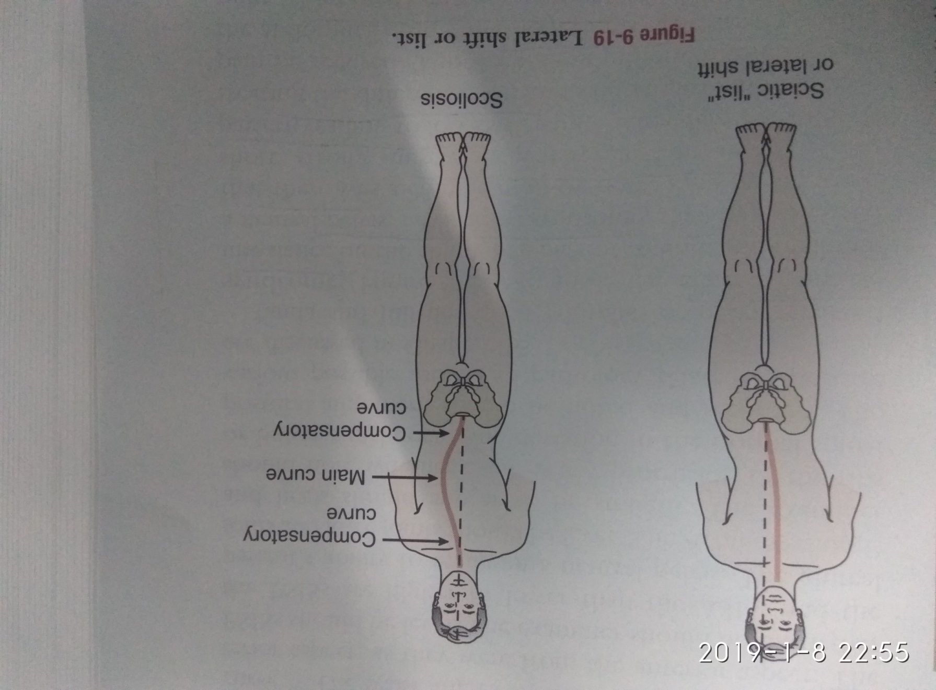

Slide 15
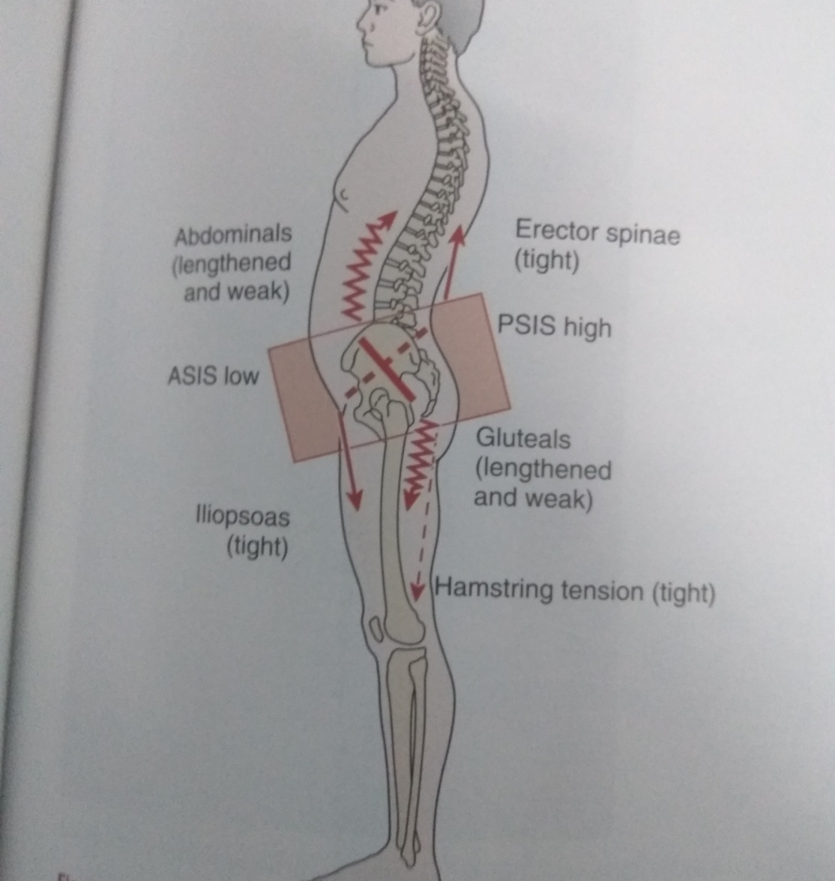
PELVIC CROSSED SYNDROME
It is the effect of muscle imbalance on the ability of a patient to hold and maintain a neutral pelvis leading to back pain.
Leads to increase in lumbar lordosis

Slide 16
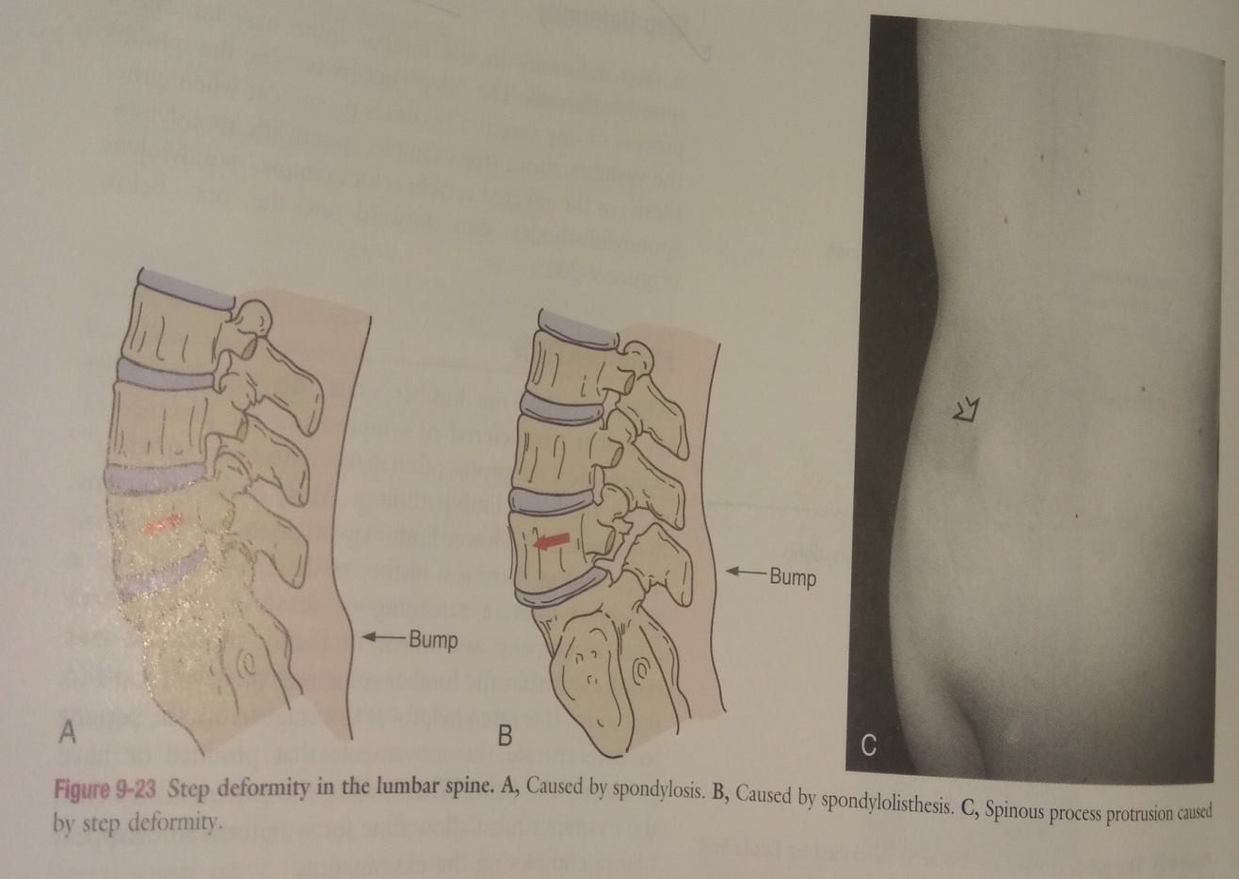
STEP DEFORMITY
A step deformity in the lumbar spine may indicate a spondylolisthesis or spondylosis
The "step" occurs because the spinous process of one vertebra becomes prominent when either the vertebra above or the affected vertebra slips forward on the one below.

Slide 17
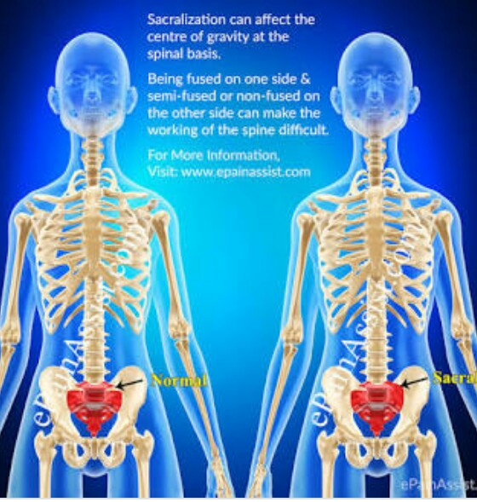
SACRALIZATION
Sacralization is a congenital anomaly in which the transverse process of the last lumbar vertebrae fuses to the sacrum or ilium. The fusion may occur on one side or both.
Sacralization often has no symptoms. It’s sometimes is associated with lower back pain or problems with posture and movement.

Slide 18
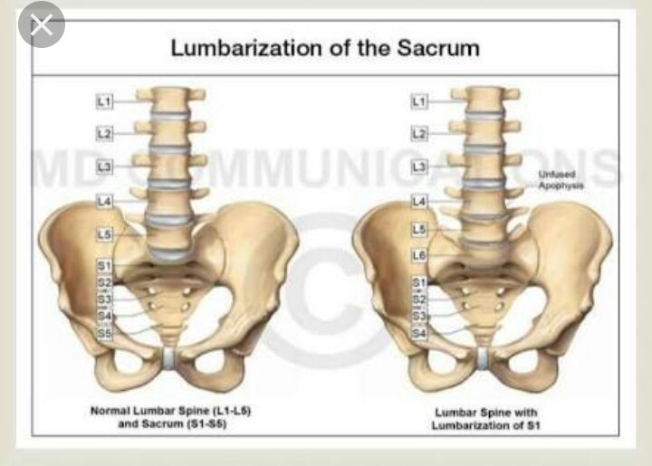
LUMBARIZATION
Lumbarization is actually a congenital abnormality, meaning it is present in an individual from birth. Here, the first sacral vertebra is not fused to the rest of the sacrum. Due to this, it appears that there are six lumbar vertebrae and only four sacral vertebrae.
Typically, patients with lumbarization of the spine can experience pain during movement. This can cause a great deal of difficulty when performing activities of daily living.

Slide 19
LOCAL PHYSICAL EXAMINATION
ON INSPECTION -
Patient position-
Deformity- Increased or decreased lordosis, any postural deformity
Bony contours - Abnormal bony contours may be palpated on spinous process
Muscle wasting - maybe multifidous muscle
Bandage/ dressing - After surgery if fixation of one vertebra with another is done with screws

Slide 20
CONTD..
ON PALPATION -
Local temperature - Increased in acute conditions
Tenderness - Spinous process, its level
Muscle spasm/ trigger points - Paraspinal muscle spasm, trigger points present in gluteus maximus muscle if gluteus maximus spasm
SENSORY EXAMINATION - If sensations are normal or no? Abnormal sensations present ( shock like burning like) checked with body chart.

Slide 21
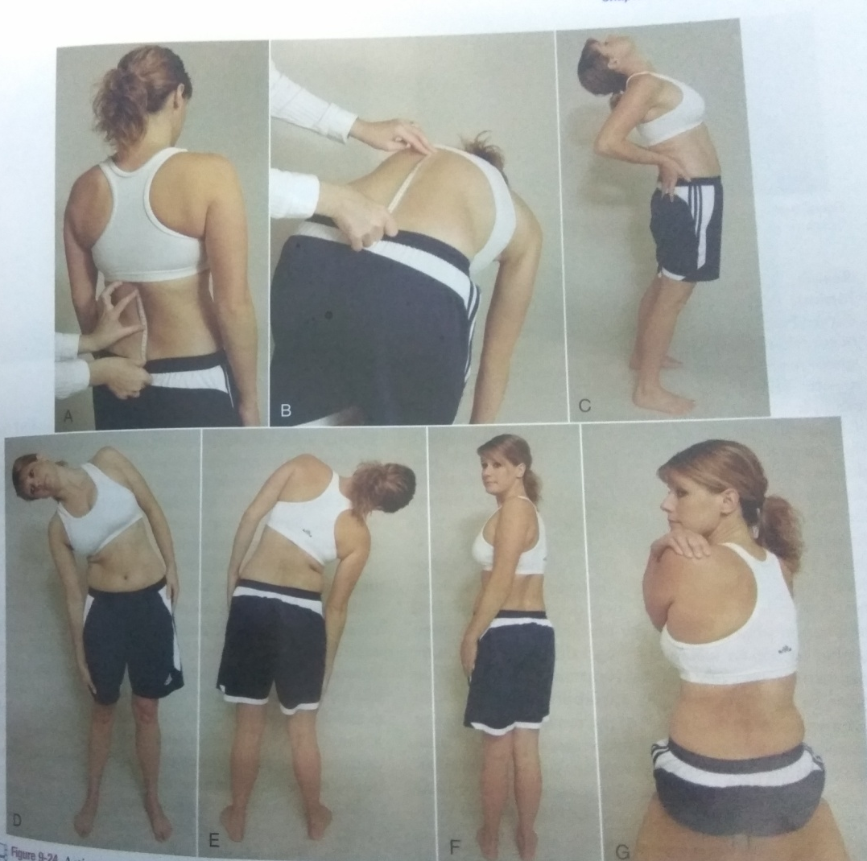
JOINT EXAMINATION
Forward flexion - 40° to 60°
Extension - 20° to 35°
Lateral flexion - 15°- 20°
ROM can be done in patients with lumvar spondylosis and mechanical back pain
ROM should not be done in patients with acute back pain and PIVD
Normal end feel - tissue stretch

Slide 22
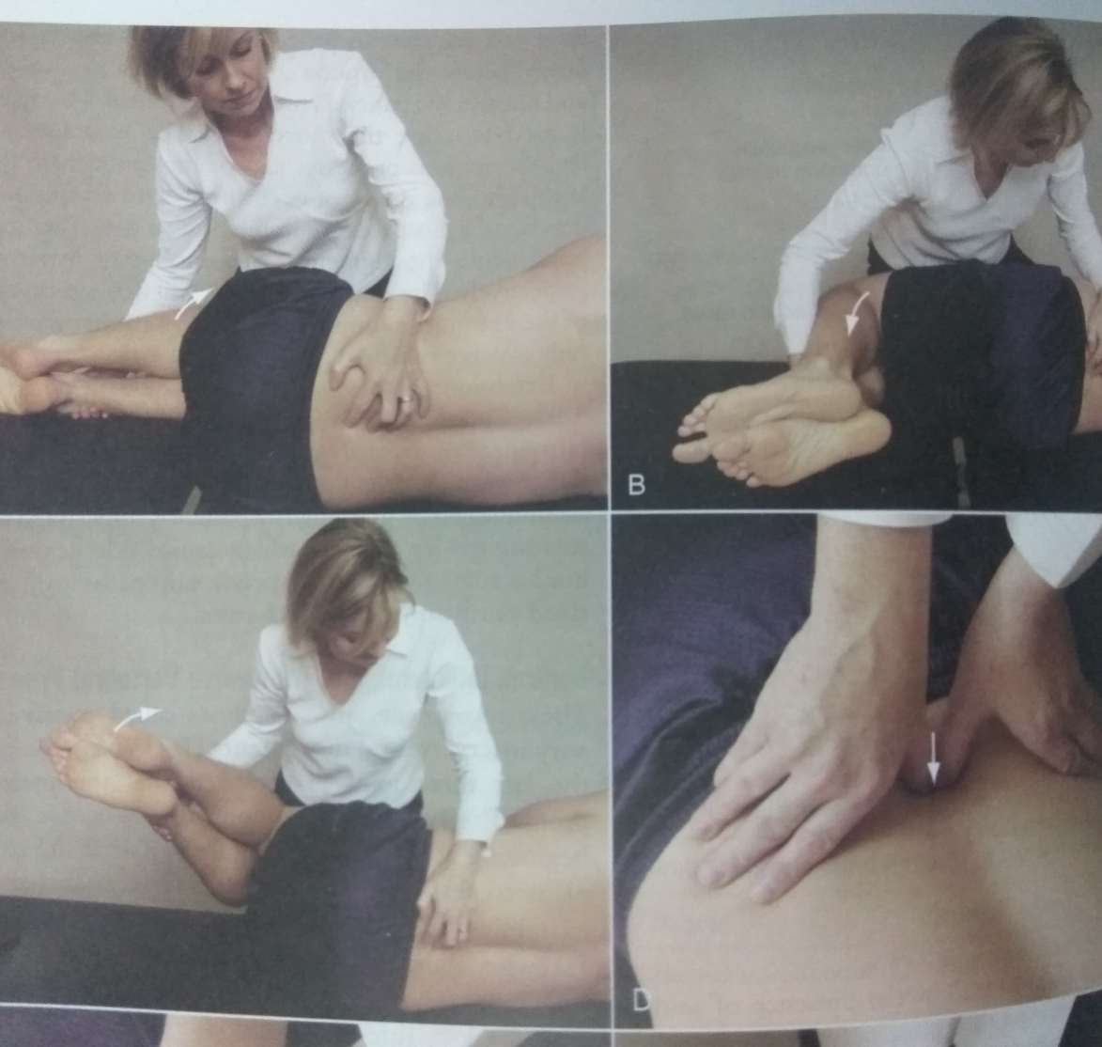
JOINT PLAY - PPIVMs
For spinal flexion - side lying, flexes both the knees, towards the chest
Palpate the spinous process with one hand, one finger on the spinous process, one finger above, one finger below the process
Examiner passively flexes and releases the patient's hip
Examiner should feel the gapping in spinous process, if no gapoing then hypomobile excessive gapping then hypermobile

Slide 23
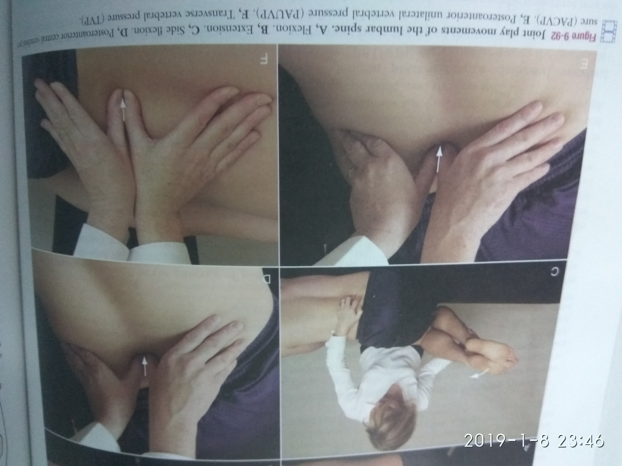
PAIVMs
Patient position is in prone lying
Palpate the lumbar spinous process from L1 to L5
Pressure is applied through thumbs with the vertebras being pushed anteriorly
Apply slow pressure and recognise the feel of the movement.

Slide 24
MUSCLE EXAMINATION
Muscle strength - MMT
Muscle length/tightness - Hip flexors, piriformis, TFL, quadriceps, dorso Lumbar fascia
Resisted isometric movements - first tested in neutral position, patient is in seated

Slide 25
NERVE EXAMINATION
Myotomes - a) L2 - Hip flexion
b) L3 - Knee extension
c) L4 - Ankle dorsiflexion
d) L5 - Great toe extension
e) S1 - Ankle plantar flexion
f) S2 - Knee flexion
Reflex testing - Patellar ( knee jerk) : L3-L4
Achilles (ankle) : S1- S2
Superficial abdominal reflex : T7 - T12

Slide 26
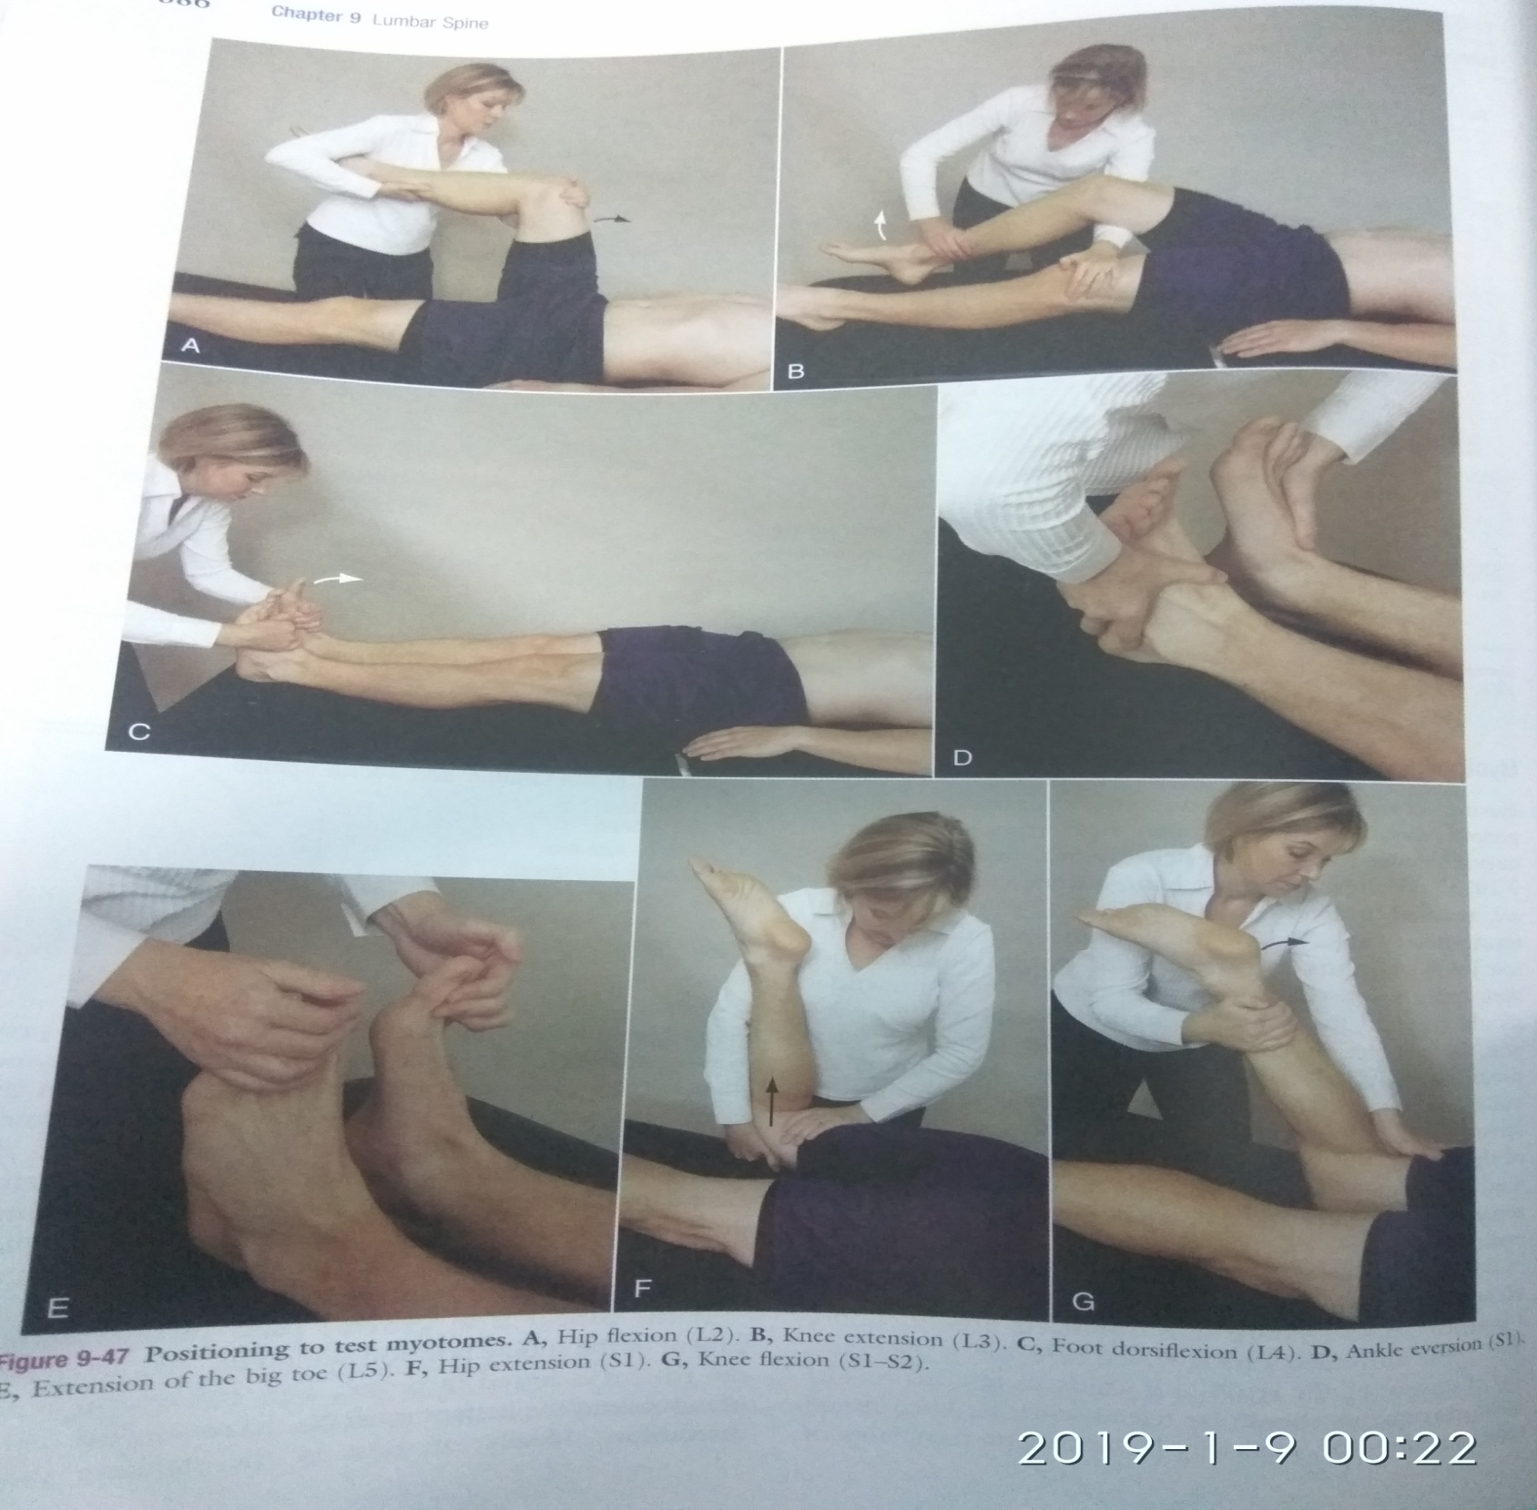

Slide 27
CONTD..
Limb length - Apparent limb length discrepancy maybe found in sciatic list
Investigations -
Plain film radiography
CT scan
MRI
Radionuclide imaging (bone scans)
Discography

Slide 28
Summary & Questions
Core muscle strength assessment
Difference between structural and functional scoliosis
Pelvic cross syndrome

Slide 29


